Slide 1

Company presentation
Company name : ARIF’S CORPORATION
Batch no: 020
Department: Environment
Date: 05-10-2024

Slide 2
Introduction
ABC Corporation was founded in 1995, specializing in innovative solutions for businesses worldwide.
Mission
To deliver exceptional value to our customers through high-quality products.
Vision
To be a global leader in sustainable and advanced business solutions.

Slide 3
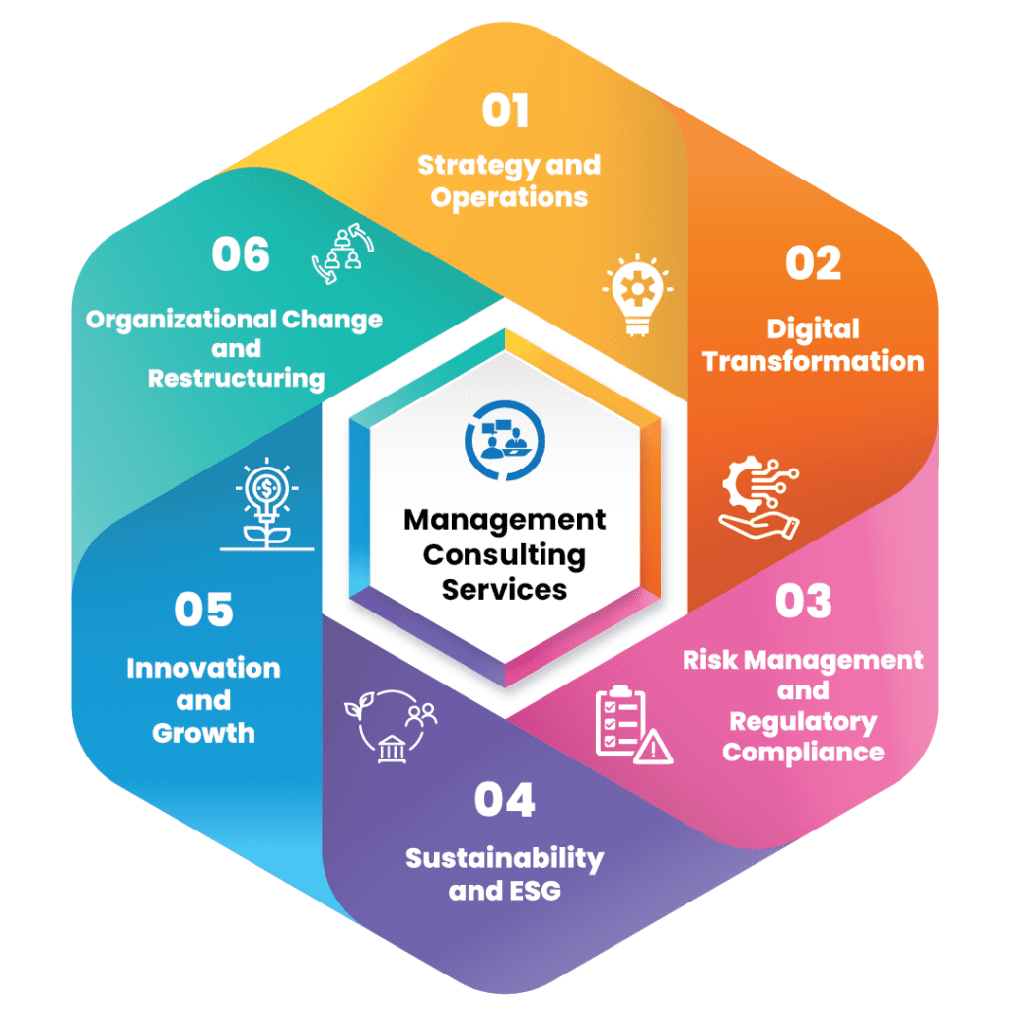


Key Products
Cloud-based Software Solutions.
AI and Data Analytics Too.
Business Consulting Services.
Key Services
Custom Software Development.
IT Infrastructure Setup and Maintenance .
Market Research and Strategy.
Cloud base
Ai
Consulting

Slide 4
Sales Trend Analysis (Placeholder Data)
Sales have grown by 10% year-on-year for the past 5 years.
Major growth areas: North America (40%), Europe (30%), and Asia (20%)
Customer Growth
Year 2021: 5,000 customers.
Year 2022: 7,500 customers. -
Year 2023: 10,000 customers.-

Slide 5

Conclusion
We are committed to continuous innovation and providing exceptional value to our customers. Thank you for your time and interest in our company.
Contact us at : marifur20.ses@bu.ac.bd.

